Slide 1

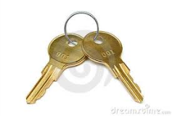
Confidentiality – Symetric & Asymetric Key
ENCRYPTION ALGORITHM
Emitter
Symetric Key
Asymetric Key
Receiver
Same key for Encryption & Decryption
Public Key for Encryption & Private for Decryption
Encryption Algorithm
Encryption Algorithm
DES, RC4, AES,…
RSA,…
Transmission Medium
Original info
Encrypted info
Notes:
Key is a set of bits, encoded on either 128, 512, 1024 bits: The longer the size of key the stronger the encryption; but in order end, the longer the size of key, much more the system need ressources and time to run/process the algorithm.
You may ask yourself, how keys are exchanged between both side without being intercepted and without the intervention on human?
Ronald Shamir Adleman

Slide 2
Integrity – Hash Algorithm : How to know if the information has been altered during transmission?
Data is discarded or rejected
HASH ALGORITHM
NO
Data
Irreversible
=
Hash
Hash
Collision Résistant
YES
Data is good
MD5, SHA-1,…
Data
Hash
Data
Hash
Data
Hash

Slide 3
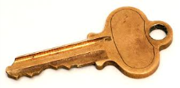

Source Authentication - Hash message Authentication Code
Data is discarded or rejected
NO
=
Data
+
Hash
Hash
YES
Data is good and source is valid
+
Data
Hash
Data
Hash
Data
Hash
Notes:
Diffie Helman Group

